Slide 1
Augmentation 요약

Slide 2
Augmentation
Hide-and-Seek
Cutout
RandomErasing
GridMask

Slide 3
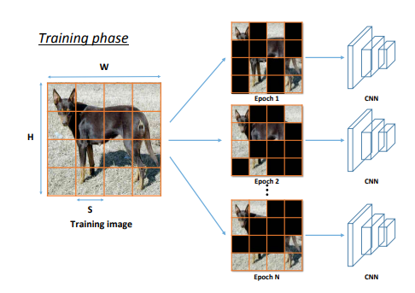
Hide-and-Seek
Blocks part of the image with the objective of obscuring the most significant area through many iterations of a random process :
랜덤 프로세스의 반복을 통해서 중요한 영역을 가릴 목적으로 image의 부분을 차단
이미지를 s x s patches로 나눈 후 랜덤하게 block
(WXH)/(SXS) 개의 patches
Ex)224X224X3 56X56X3->16개의 patches
단점: 동일한 사이즈로 실행되는 것이라 동일한 level의
Occlusion만 발생

Slide 4
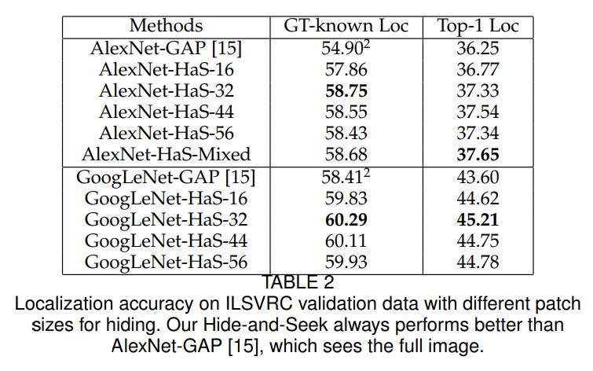
Hide-and-Seek : object localization results
ILSVRC2016의 평가 방식을 이용함 validation data만 공개됨
Top-1 Loc: fraction of images for which the predicted class with the highest probability is the same as the ground-truth class and the predicted bounding box for that class has more than 50% IoU with the ground-truth box
GT-known Loc: fraction of images for which the predicted bounding box for the ground-truth class has more than 50% IoU with the ground-truth box.
patch sizes N = {16, 32, 44, 56}
=>patch sized 가 32일 때 결과가 제일 좋음

Slide 5
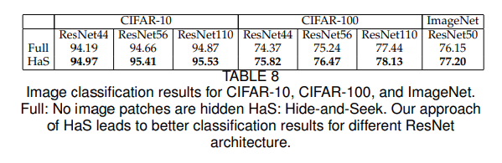
Hide-and-Seek :image classification results
CIFAR-10, CIFAR-100 사용
CIFAR, the patch size is set to be 8(image가 32X32라서)
ImageNet the patch size is chosen randomly from 16, 32, 44, and 56.

Slide 6
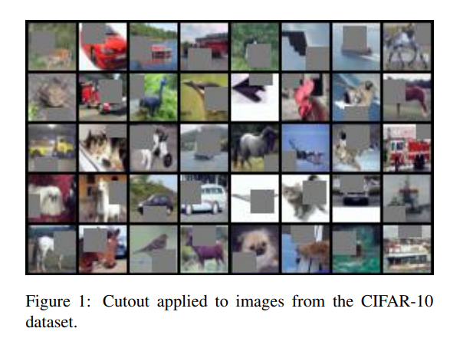
Cutout
Occlusion을 모방하는 발견 메커니즘으로 중요한 영역을 랜덤하게 masking
https://hoya012.github.io/blog/Improved-Regularization-of-Convolutional-Neural-Networks-with-Cutout-Review/
CIFAR-10, CIFAR-100, SVHN,and STL-10 dataset
데이터셋 종류로 보아 classification test

Slide 7
Experiment settings
we compare the average magnitude of feature activations in a ResNet18 when trained with and without cutout on CIFAR10. The models were trained with data augmentation using the same settings as defined in Section 4.1, achieving scores of 3.89% and 4.94% test error respectively.
we train models using two modern architectures: a deep residual network [5] with a depth of 18 (ResNet18), and a wide residual network [22] with a depth of 28, a widening factor of 10, and dropout with a drop probability of p = 0.3 in the convolutional layers (WRN-28-10).
we train for 200 epochs with batches of 128 images using SGD, Nesterov momentum of 0.9, and weight decay of 5e-4. The learning rate is initially set to 0.1, but is scheduled to decrease by a factor of 5x after each of the 60th, 120th, and 160th epochs. We also apply cutout to shake-shake regularization models [4] that currently achieve state-of-the-art performance on the CIFAR datasets, specifically a 26 2 × 96d “Shake-Shake-Image” ResNet for CIFAR-10 and a 29 2 × 4 × 64d “Shake-EvenImage” ResNeXt for CIFAR-100

Slide 8
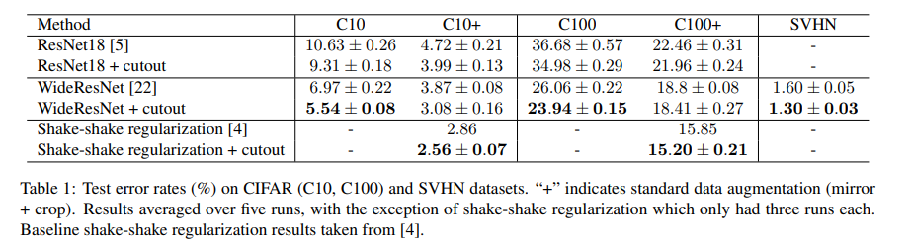
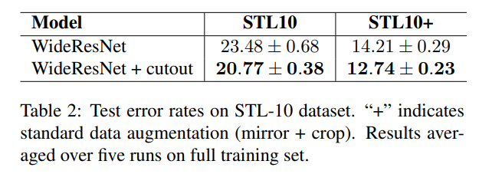
Cutout: result
Error 감소가 잘 되는 듯
근데 cutout만 쓰는 것보다는
다른 augmentation과 함께 쓰는 게
더 좋아 보임

Slide 9
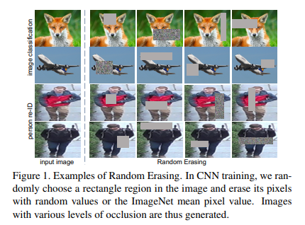
RandomErasing
이미지의 일부분을 랜덤 값이나 평균 픽셀로 바꾸는 것
Cutout 은 지운 부분을 0으로 셋팅하고, Erasing 은 랜덤값으로 셋팅하는 것이 차이다.
https://deepapple.tistory.com/8
image classification :CIFAR-10 and CIFAR-100, and a new dataset Fashion-MNIST
object detection: PASCAL VOC 2007
“trainval” set for training and “test” set for testing
person re-identification (re-ID): Market-1501,
DukeMTMC-reID,CUHK03

Slide 10
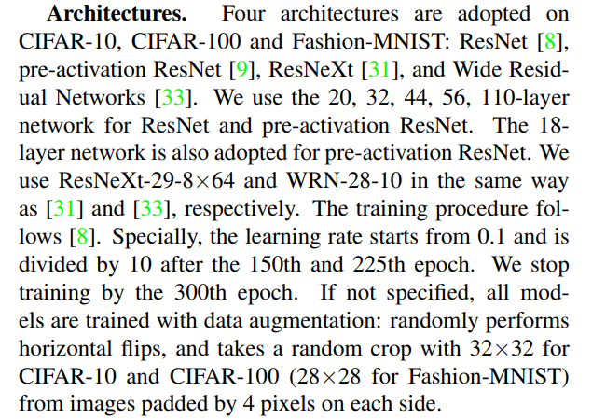
Experiment settings
Note that some popular regularization techniques (e.g., weight decay, batch normalization and dropout) and various data augmentations (e.g., flipping, padding and cropping) are employed.

Slide 11
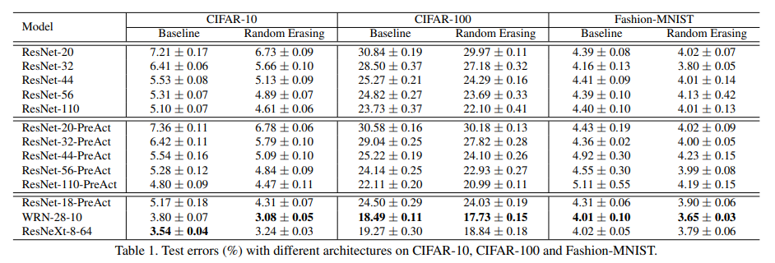
RandomErasing:classification results

Slide 12
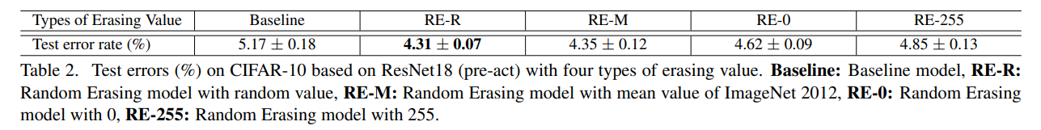
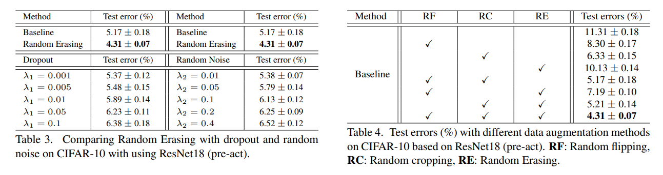
RandomErasing: classification results

Slide 13
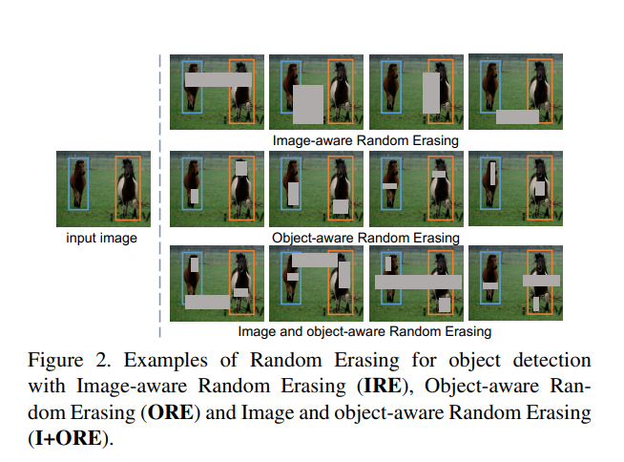
RandomErasing: classification results

Slide 14
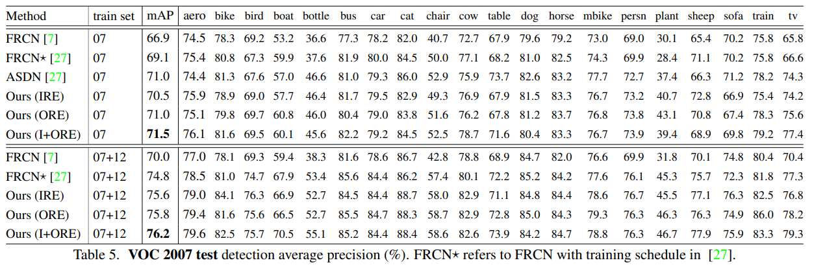
RandomErasing:classification results

Slide 15
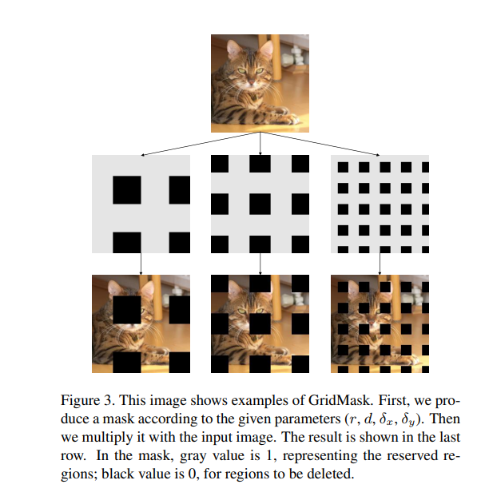
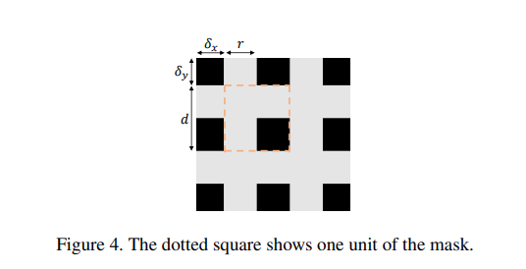
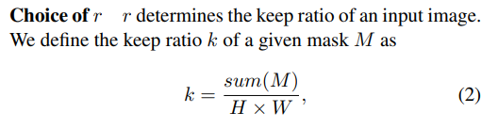

GridMask
논문에서 고정된 수식

Slide 16
Experiment settings
We experiment with a wide range of differently sized models, from ResNet50 to ResNet152. We train them with our augmentation on ImageNet from scratch for 300 epochs. The learning rate is set to 0.1, decayed by 10-fold at epochs 100, 200, 265. We train all our models on 8 GPUs, using batchsize 256 (32 per GPU). For the baseline augmentation, we follow the common practice. We first randomly crop a patch from the original image and then resize the patch to the target size (224 × 224). Finally, the patch is horizontally flipped with a probability of 0.5.
we only use GridMask along with the baseline augmentation. We choose r = 0.6, and we linearly increase the probability of GridMask from 0 to 0.8 with the increasing of training epochs until the 240th epoch, and then keep it until 300 epochs

Slide 17
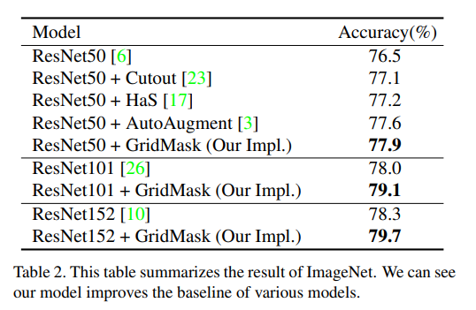
GridMask: classification results
We train them with our augmentation on ImageNet from scratch for 300 epochs.
The baseline augmentation including randomly deforming the brightness, contrast, saturation, and hue of the input image. And then the image is randomly scaled into a certain range. After that, a horizontal flip operation is randomly applied to the scaled image.
Finally, the image is normalized to around zero. Our GridMask is used after the baseline augmentation.

Slide 18
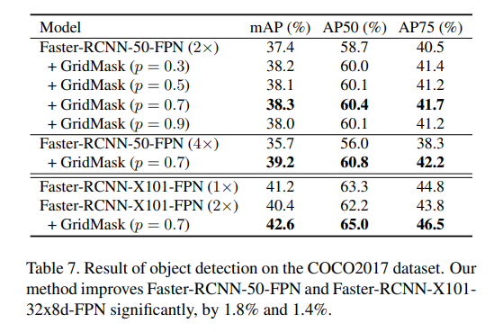
GridMask: detection results
Finally, the image is normalized to around zero. Our GridMask is used after the baseline augmentation(Cutout,Has,Autoaugmentation).
R=0.5
A natural variation is to break the structure and randomly drop a block in every unit with a certain probability of pu.
In the task of COCO2017 object detection, we improve the baseline by 1.8%

Slide 19
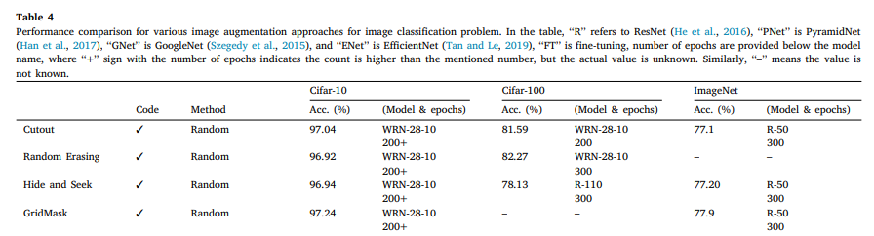
Conclusion

Slide 20
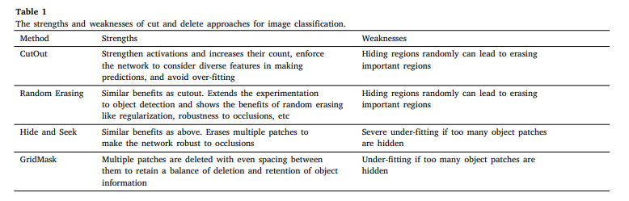
Conclusion

